Slide 1
CT State Library Digital Navigator Grant Project
Presented by the CT State Library and the Digital Navigator Project Libraries

Slide 2
Presenters
Christine Gauvreau, LSTA/eRate Coordinator, Digital Navigator Project Manager
Sarah Kline Morgan, Library Director, East Hartford Public Library
Maisam Nouh, Information Technology Supervisor, The Ferguson Library, Stamford
Melissa Canham-Clyne, Director, Hamden Library
Julie Styles, Asst. Director of Public Services, Hartford Public Library

Slide 3
Digital Inclusion & Navigation
A National and State Priority
Federal Infrastructure Investment & Jobs Act
Digital Equity Act: $2.75 B; includes planning & capacity grants that states will administer
BEAD, the Broadband Equity, Access, & Deployment Program: $42.5B (CT will get at least $100 M)
Affordable Connectivity Program: $14.2B (Emergency Broadband Benefit)

Slide 4
Digital Inclusion
. . refers to the activities necessary to ensure that all individuals and communities, including the most disadvantaged, have access to and use of Information and Communication Technologies (ICTs).
This includes 5 elements:
1) affordable, robust broadband internet service;
2) internet-enabled devices that meet the needs of the user;
3) access to digital literacy training;
4) quality technical support; and
5) applications and online content designed to enable and encourage self-sufficiency, participation and collaboration.

Slide 5
Digital Navigation
National Digital Inclusion Alliance– community of practice developing best practices for infrastructure, but also the people-to-people components and partnerships to advance toward equity as moral imperative
New people-centered pilot projects in Illinois, Vermont, Salt Lake City, etc. -- promoted by library professionals and including Digital Navigator train the trainers, armies of mentors, etc.
CT State Library Digital Navigator Pilot Project Grants- $100,00 grants to 4 libraries to demonstrate the place of libraries in the new navigation ecosystem in our state

Slide 6
Challenge for Libraries & Partners
23% of all CT households lack high speed internet at home
36% of low-income CT households lack high speed internet at home (compared to 11% of all other households)
35% of Latinx households lack wireline broadband at home
34% of African American do not have wireline broadband at home
29% of lower-income households with children do not have wireline broadband at home
45% of CT residents with a disability do not have wireline broadband
Our Responses:
Digital Navigation Pilot Projects Anchored in Libraries
Connecticut Libraries and Partners for Digital Equity

Slide 7
A National and State Priority
State of CT: “Everyone Learns” : $435 million, 40 towns, 200 hotspots (many of hotspots will have to be libraries)
Consolidated Appropriations Act, 2021: Congress established the Emergency Broadband Connectivity Fund and allocated $3.2 billion for the Emergency Broadband Benefit Program. The aim is to connect low-income households with six months of support.
National Digital Inclusion Alliance– community of practice developing best practices for infrastructure, but also the people-to-people components and partnerships to advance toward equity as moral imperative
New people-centered pilot projects in Illinois, Vermont, Salt Lake City, etc. -- promoted by library professionals and including Digital Navigator train the trainers, armies of mentors, etc.
Infrastructure and Jobs Act

Slide 8
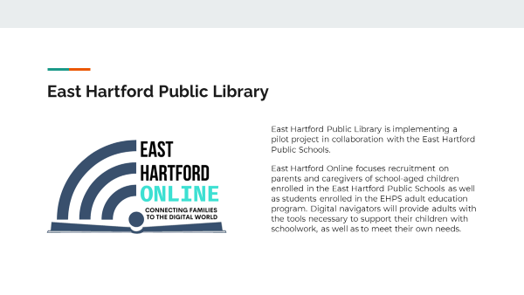
East Hartford Public Library

Slide 9
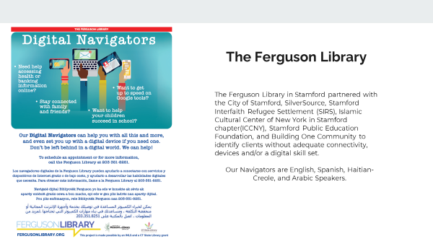
Ferguson Library, Stamford: Stamford Digital Navigators

Slide 10
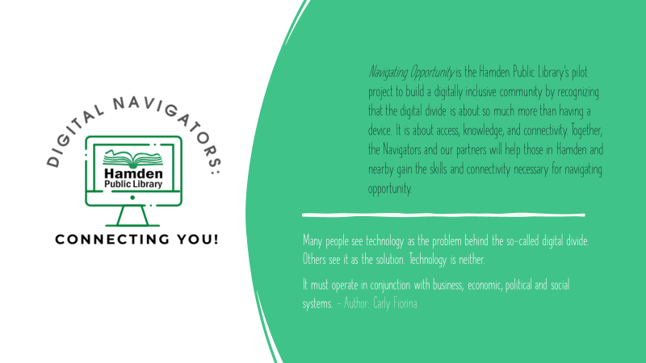
Hamden Library: Navigating Opportunity

Slide 11
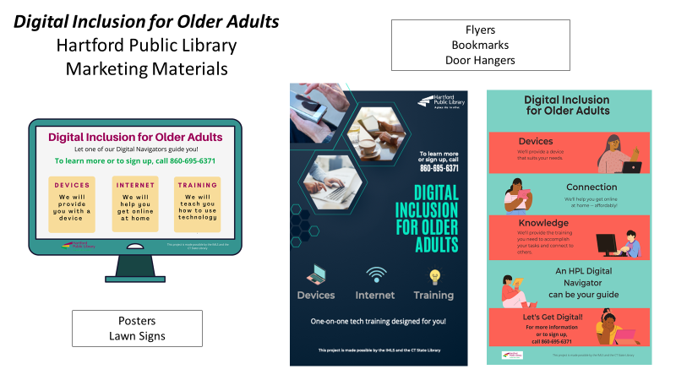
Hartford Public Library: Digital Inclusion for Older Adults

Slide 12
Why this is important, and what you can do.
Library trustees can support their libraries by being informed and aware of the impact of the digital inequity in their communities and at the state and national level.
DLD will be recruiting members for our group CT Libraries and Partners for Digital Equity and would welcome local library board members to ensure that public libraries have a seat at the table to address digital inclusion and equity in Connecticut.

Slide 13
For More Information
For more information on CSL/DLD’s Digital Inclusion initiative, please contact Dawn La Valle at dawn.lavalle@ct.gov.
Digital Navigator Pilot - ARPA Grants to CT Public Libraries - LibGuides Home at Connecticut State Library, Division of Library Development (ctstatelibrary.org)

