Slide 1
ACLB 2018 Leadership Conference
Hiring a New Director Panel
Association of
Connecticut Library Boards

Slide 2
Presenters
Facilitator – Cynthia Sanders, ACLB Vice-Chair
Donna Lanza, Director of Administrative Services ,Town of Hebron
Geen Thazhampallath, Board President, Russell Library, Middletown, CT
Ken Wiggin, State Librarian, CT State Library

Slide 3
Hiring a New Library Director
The single most important decision of the library board is the selection and appointment of the library director. Finding and retaining a good library director is vital to creating excellent library service for your community.
When the need first arises to find another director, the board should use the opportunity to assess the qualifications and skills they will be looking for in the person that will lead their library in the coming years.

Slide 4
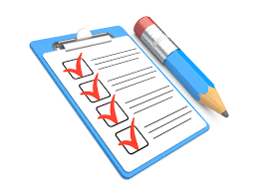
ACLB Handbook Checklist: Chapter 6: Director
1. Review the library’s mission statement, long-range plans, and short term goals.
2. Conduct an exit interview with the current director, if possible.
3. Discuss vacancy with the municipality if the situation warrants.
4. Review the current job description and amend as needed.
5. Review skills and abilities the new director should possess to best achieve the board’s goals for the library.
6. Budget for the expenses the board will incur for any consultants, ads, travel.
7. Set a competitive range for salaries and benefits to be used in the selection and hiring.
8. Draft the Job Description.
9. Form the Search Committee.
10. Advertise. Chapter 6: The Library Director
11. Affirmative Action
12. Evaluation of Applications.
13. Supply candidates who will be interviewed with additional information about the library.
14. Interviewing and Selection.
15. Interviews Completed..
16. Final Steps.
17. Welcoming the New Director.
https://aclb.wildapricot.org/

Slide 5
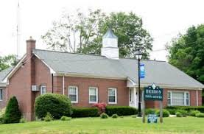
Library Director Hiring Perspectives: Town Government

Slide 6
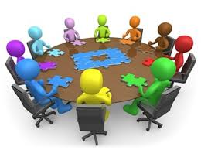
Hiring Perspectives: Board Member

Slide 7
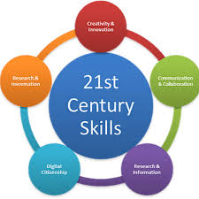
Hiring Perspectives: National Trends and Best Practice
https://libguides.ctstatelibrary.org/dld/bestpractices

