Slide 1
ACLB’s Library Board of Trustees Board Assessment Tool
Using Self Assessment Tools to Ensure Competencies Essential to the Role of Library Board Members
ACLB Virtual Workshop, November 19th, 2020

Slide 2
Presented by the ACLB Executive Board Gail Richmond, ACLB President

Slide 3
Why Assess Your Board? – ALA ,United for Libraries “A Library Board’s Practical Guide to Board Self Evaluation,” Spring 2008
Trustees and Library Commissioners make important fiscal and administrative decisions critical to the functioning of their library. Board members commit their time and skills for effective governing. It is important that they understand their roles and responsibilities and possess the information necessary to make wise decisions as a Board.
Library environments are in continuous flux and Board composition changes as terms expire and new members arrive. It is not always possible for all members to possess the competencies needed to operate as a team in addressing the needs and concerns of the library, particularly when Trustees arrive on the Board with varied experience.
An annual self-evaluation tool can assist Trustees to assess the competencies essential to their performance as Board members. Further, it will assist them in seeking opportunities for training and continuing education and adjust individual perception of operation and gaps in information.

Slide 4
Assessment Tool for Connecticut Library Boards
It is important for Library Boards to engage in self-assessment to identify how they are performing, that is, how well they are fulfilling their roles and responsibilities and where they might improve.
We, the Executive Board of the Association of Connecticut Library Boards have developed the attached self-assessment instrument to assist your Library Board in determining its strengths and weaknesses. We recommend that an assessment be undertaken every two years.
Although we have written this instrument for the Board to self-assess we also recommend that individual board members assess themselves anonymously to gain insight into their own personal performance.
Boards have fiscal and administrative decisions to make which effect the functioning of their library. A self-assessment will enable a Board to obtain the information necessary to make decisions as a Board.

Slide 5
ACLB Assessment Tool
The attached instrument is divided into key sections with sub-categories in each. The assessment does not need to be administered in one sitting.
Please divide it into sections as convenient for the Board.
The individual items should be evaluated using a five-point scale:
1. Needs improvement
2. Marginal
3. Acceptable
4. Excellent
5. Do not know

Slide 6
General Knowledge | Needs improvement | Marginal | Acceptable | Excellent | Do not know
Board members know the history of the library | ¡ | ¡ | ¡ | ¡ | ¡
Board members know the library’s mission statement | ¡ | ¡ | ¡ | ¡ | ¡
Board members are familiar with the strategic plan | ¡ | ¡ | ¡ | ¡ | ¡
Board members are familiar with the library’s policies | ¡ | ¡ | ¡ | ¡ | ¡
Board members understand their role and responsibilities | ¡ | ¡ | ¡ | ¡ | ¡
Board members are familiar with the organizations structures of the library | ¡ | ¡ | ¡ | ¡ | ¡
Board members are familiar with the union contracts covering library staff if applicable | ¡ | ¡ | ¡ | ¡ | ¡
Board members are familiar with Library Director’s contract if applicable | ¡ | ¡ | ¡ | ¡ | ¡
Board members have reviewed the ACLB Public Library Trustee Handbook | ¡ | ¡ | ¡ | ¡ | ¡
Comments:

Slide 7
Board Operation | Needs improvement | Marginal | Acceptable | Excellent | Do not know
The agenda of board meetings is well planned | ¡ | ¡ | ¡ | ¡ | ¡
Board members come to meetings prepared and on time | ¡ | ¡ | ¡ | ¡ | ¡
Board meetings begin and end on time | ¡ | ¡ | ¡ | ¡ | ¡
The meeting agenda is followed | ¡ | ¡ | ¡ | ¡ | ¡
There is an onboarding process for new members (orientation) | ¡ | ¡ | ¡ | ¡ | ¡
Board members serve on committees as needed and contribute accordingly | ¡ | ¡ | ¡ | ¡ | ¡
Board members listen respectfully and encourage others to express their views | ¡ | ¡ | ¡ | ¡ | ¡
Comments:

Slide 8
Advocacy | Needs improvement | Marginal | Acceptable | Excellent | Do not know
Board members promote the library | ¡ | ¡ | ¡ | ¡ | ¡
Board members are familiar with the library’s advocacy plan | ¡ | ¡ | ¡ | ¡ | ¡
Board members are aware that a municipal board cannot fund raise | ¡ | ¡ | ¡ | ¡ | ¡
Comments:

Slide 9
Decision Making | Needs improvement | Marginal | Acceptable | Excellent | Do not know
Board members support board decisions once they are made | ¡ | ¡ | ¡ | ¡ | ¡
The library director is present and an active participant in the board meetings | ¡ | ¡ | ¡ | ¡ | ¡
Comments:

Slide 10
Strategic Planning | Needs improvement | Marginal | Acceptable | Excellent | Do not know
The Board understands community needs assessment | ¡ | ¡ | ¡ | ¡ | ¡
The Board participates in the development of a strategic plan | ¡ | ¡ | ¡ | ¡ | ¡
Board members can effectively communicate the strategic plan | ¡ | ¡ | ¡ | ¡ | ¡
Comments:

Slide 11
Policy Making | Needs improvement | Marginal | Acceptable | Excellent | Do not know
The Board works with the library director to develop effective and relevant policies | ¡ | ¡ | ¡ | ¡ | ¡
Policies reflect the needs of the community | ¡ | ¡ | ¡ | ¡ | ¡
The Board supports the library staff in the enforcement of library policies | ¡ | ¡ | ¡ | ¡ | ¡
Policies are reviewed annually and are readily available to staff and the public | ¡ | ¡ | ¡ | ¡ | ¡
Comments:

Slide 12
Finance | Needs improvement | Marginal | Acceptable | Excellent | Do not know
The Board has financial oversight for the judicious expenditure of the budget | ¡ | ¡ | ¡ | ¡ | ¡
Board members are familiar with the library’s budget | ¡ | ¡ | ¡ | ¡ | ¡
The Board works with the Library Director to develop the annual budget | ¡ | ¡ | ¡ | ¡ | ¡
The Board attends Board of Finance meetings to support the library budget | ¡ | ¡ | ¡ | ¡ | ¡
Board members can effectively communicate the library budget to interested parties | ¡ | ¡ | ¡ | ¡ | ¡
Comments:

Slide 13
Professional | Needs improvement | Marginal | Acceptable | Excellent | Do not know
The Board is responsible for an evaluation of the Library Director | ¡ | ¡ | ¡ | ¡ | ¡
Board members attend trustee learning experiences/conferences as available | ¡ | ¡ | ¡ | ¡ | ¡
Comments:

Slide 15
Steps to Develop a Plan of Action |  | Completed
1 | Identify core deficiencies noted in the Board Assessment Tool | ¡
2 | Identify resources and training: ACLB website [https://aclb.wildapricot.org/] Contact ACLB for available consultation, training, and mediation United for Libraries [http://www.ala.org/united/] | ¡
3 | Schedule training, meeting, or review of resources to address deficiencies: Establish timeline for training Ensure that all board members are present for training Determine outcome for training – address identified deficiency | ¡
4 | Board retakes Board Assessment Tool to ensure all deficiencies are met | ¡
5 | Schedule next Board Assessment | ¡

Slide 16
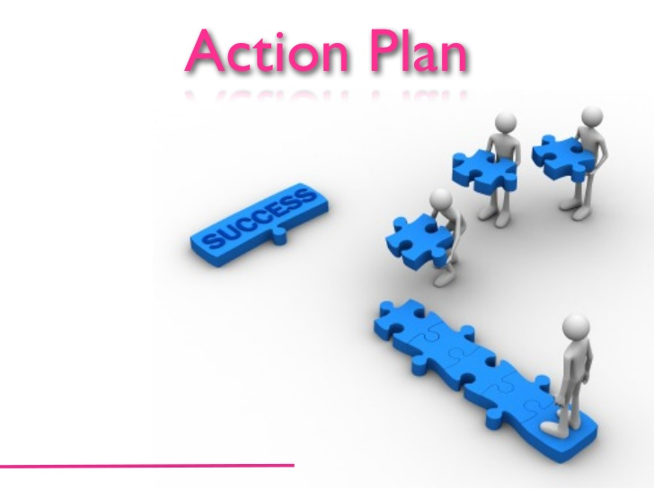
Plan of Action
Reflect on your responses and comments. Record ideas and potential priorities for consideration as the Board creates an action plan in response to this self-assessment activity.
Steps to Develop a Plan of Action:
Identify the core deficiencies noted in the Board Assessment Tool.
Identify appropriate resources and training available
ACLB Handbook, Website, Executive Board
CSL/DLD Libguide: CT Libraries Help Center
ALA United for Libraries
Schedule training, consulting, or review of ACLB Handbook to address deficiencies:
Establish a timeline for addressing deficiencies.
Ensure that all board members are present for training.
Determine outcomes for training – addressing deficiencies.
4. Board retakes Board Assessment Tool to ensure all deficiencies are met.
5. Schedule next Board Assessment

Slide 17
Resources
ACLB Handbook:
https://aclb.wildapricot.org/
CSL, Division of Library Development:
https://libguides.ctstatelibrary.org/dld/help
ALA United for Libraries:
http://www.ala.org/united/trustees

Slide 18
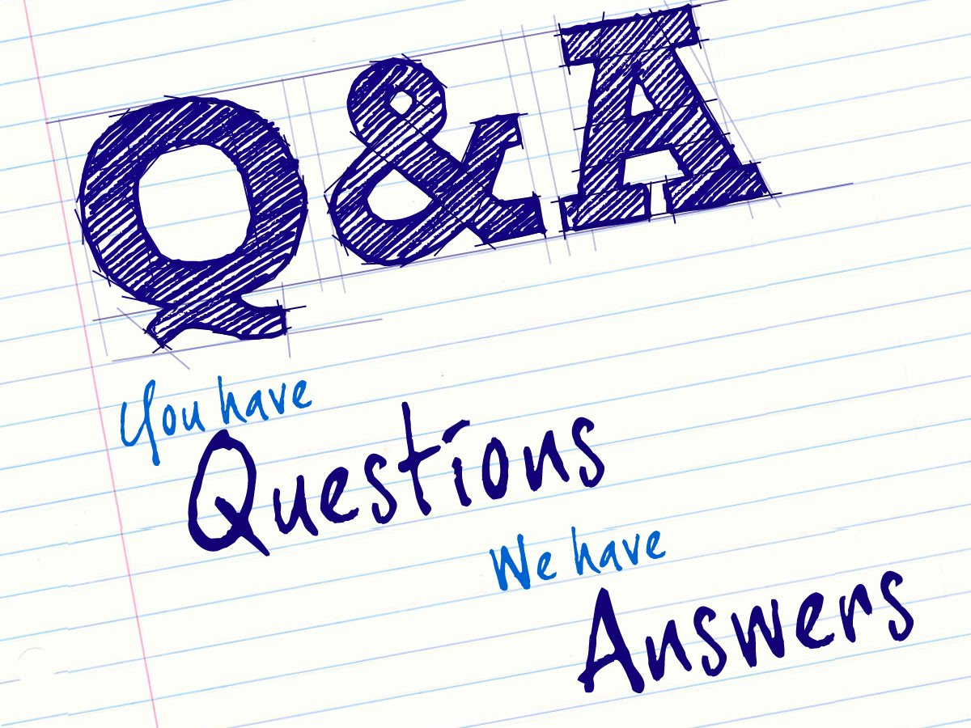
This Photo by Unknown Author is licensed under CC BY-NC-ND

Slide 19
Thank you!

